Slide 1
React/Redux 101
Presented by Evgeniy Razinkov

Slide 2



Agenda
Introduction to React
Virtual DOM
Props
State
Lifecycle
What is Flux
History
How it works
Implementations
What is Redux
Overview
Flow
Examples
‹#›

Slide 3
Introduction to React
React is a UI library developed at Facebook.
Lets you create interactive, stateful or stateless, reusable UI components.
React can be used on both the client and server side.
Lets you write HTML tags in javascript to simplify creating components(JSX).
Uses a Virtual DOM to selectively render subtrees of components on state change.

Slide 4
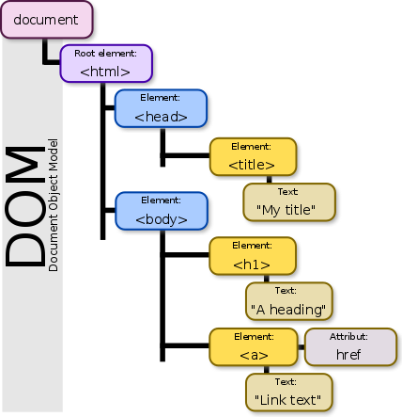
Introduction to React: Virtual DOM
DOM (Document Object Model) – programming API for HTML and XML documents. It defines the logical structure of documents and the way a document is accessed and manipulated.
document.getElementsByTagName('h1')[0].innerHTML='new'
Main problem:
It can be slow – modifying the actual-DOM is a costly operation, and modifying the DOM on every change can be cause poor performance.

Slide 5
Introduction to React: Virtual DOM
What is Virtual DOM?
Virtual DOM was created to deal with performance issues. It’s a tree of JavaScript objects that represents the actual DOM.
React’s Virtual DOM is a tree of ReactElements

Slide 6
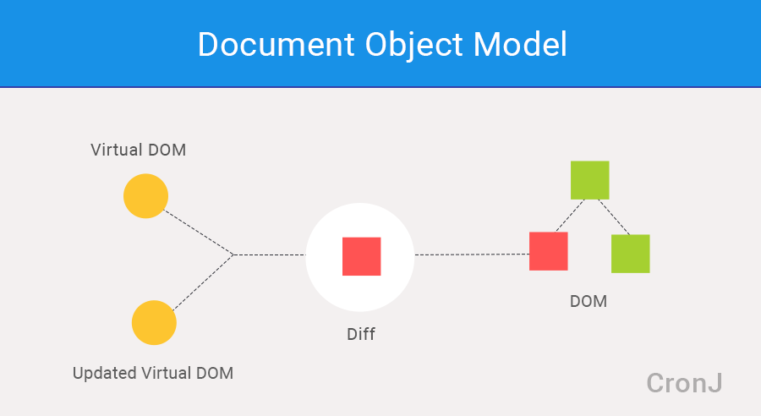
How virtual DOM works?
When state changes:
React builds a new virtual DOM subtree
Diffs it with the old one
Computes the minimal set of DOM mutations and puts them in queue
Batch executes all updates

Slide 7
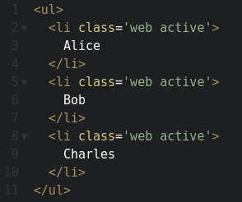
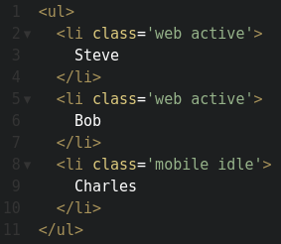
Example
list.childNodes[0].textContent = ‘Steve’
list.childNodes[2].className = ‘mobile idle’

Slide 8
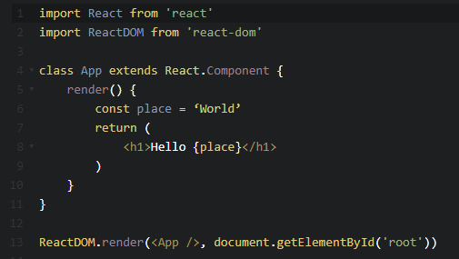
Hello world

Slide 9
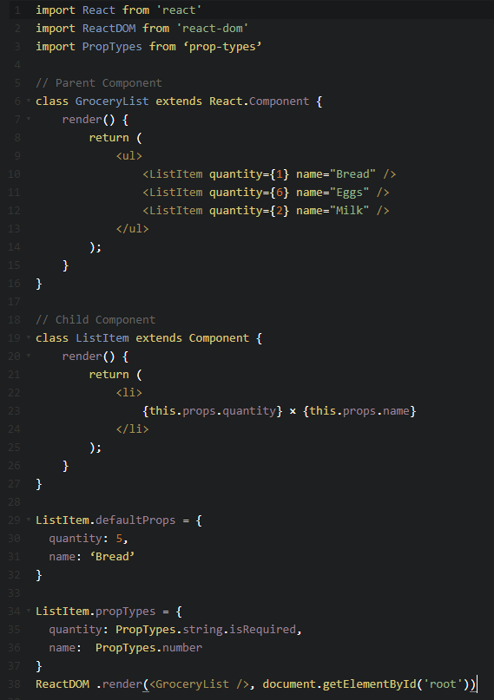
Composition

Slide 10
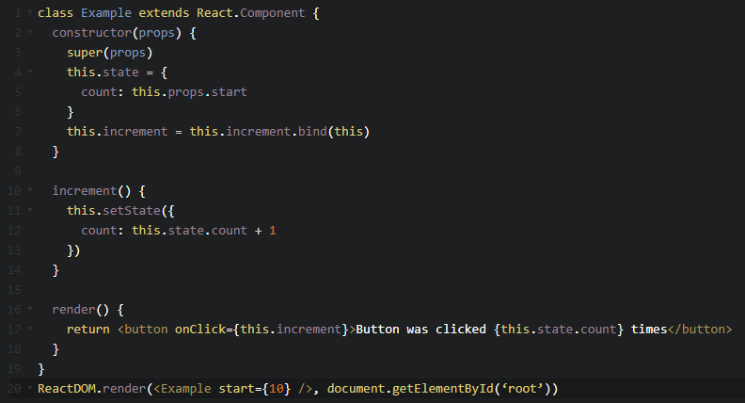
State

Slide 11
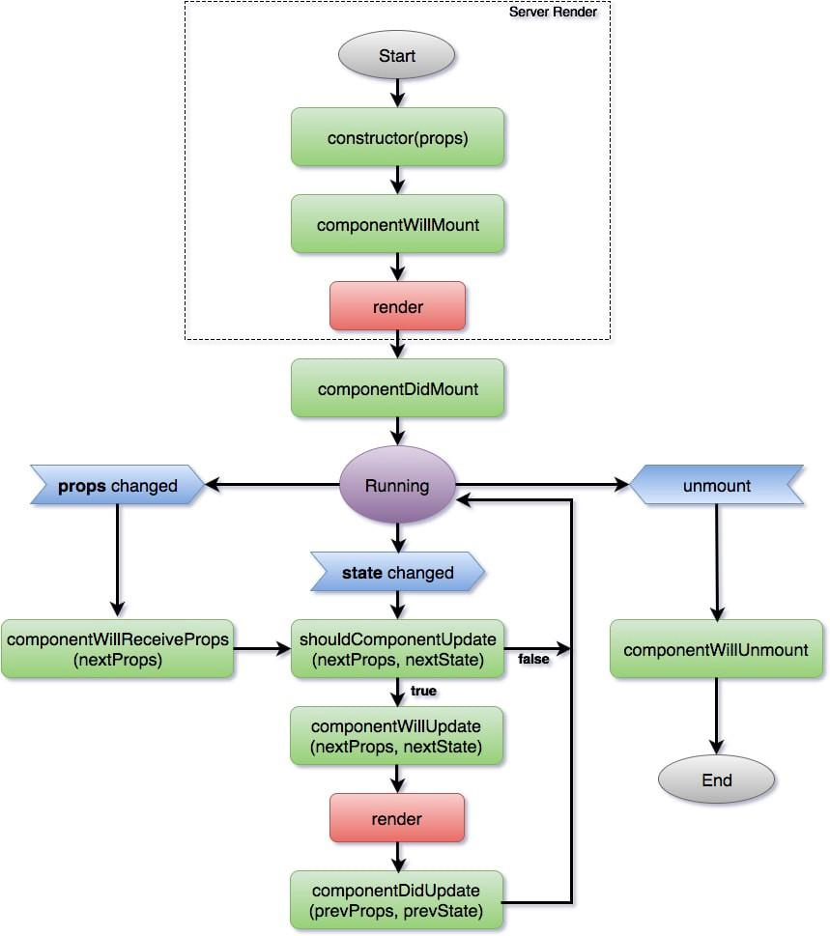
Lifecycle

Slide 12
Lifecycle
Constructor
This method is called when your component is being created and before mounting (being added to the DOM). Its primary use is to initialize state and .bind(this) for the component’s methods. If you do neither of these, then there is no need for a constructor.
componentWillMount
This method is executed right before a component is added to the DOM / render(). It is generally recommended that you use the constructor, but this method is still included in the API mostly for backwards compatibility.
You should avoid calling any functions that cause side effects in this method as setState won’t trigger a change and there is no DOM to interact with.

Slide 13
Lifecycle
componentDidMount
Your component has now been rendered and exists in the DOM. This is the point when you should initiate AJAX requests, add event listeners, and perform any set up that requires a DOM. Calling setState during this method or any time after will cause a re-render.
componentWillReceiveProps(nextProps)
When your component receives new props from its parent, componentWillReceiveProps is triggered. This is a great time to check if there are changes in the incoming props when compared to your current props and trigger a state change based on the new values. A common use-case for this is resetting state based on a change.

Slide 14
Lifecycle
shouldComponentUpdate(nextProps, nextState)
This method exists purely for performance improvements. Renders and reconciliations are expensive in React.
shouldComponentUpdate provides the developer the ability to return a boolean true/false from this method which controls whether React should perform the reconciliation operations and DOM updates.
The default behavior is for React to render every update, which works in most cases. If shouldComponentUpdate() returns false, then componentWillUpdate(), render(), and componentDidUpdate() will not be invoked.

Slide 15
Lifecycle
componentWillUpdate(nextProps, nextState)
React invokes this method immediately before rendering when new props or state are being received. There is not much use for componentWillUpdate and should probably be avoided (similar to componentWillMount). You should not do anything that would change the state at this point — use componentWillReceiveProps if you need to do anything before a render.
componentDidUpdate(prevProps, prevState)
Immediately after React builds you a shiny new UI, componentDidUpdate is invoked. This is a great time to interact with the DOM or instantiate a new network request based on what the new interface should look like.

Slide 16
Lifecycle
componentWillUnmount
Your component had a great life and now it’s time for it to leave the UI. This is the moment to clean up everything that was associated with adding and maintaining your component while it was living on the UI.
componentDidCatch (error, info)
It is a new lifecycle that was added in React 16. React was notorious for crashing the an entire application if a JavaScript error was thrown inside the React app. It corrupted React’s internal state which blew up the app and yielded cryptic error messages.
componentDidCatch solves this by catching any JavaScript error occurring in a component’s tree for the children of the component that implements the method. It is able to capture the error and display a fallback UI.

Slide 17
Flux Architecture
Flux is the architecture that Facebook uses for building client-side web apps
It’s a pattern, not a framework
Flux doesn’t follow MVC in favor of a unidirectional data flow
Flux architecture is composed of four major parts: Actions, Dispatchers, Stores, Views

Slide 18

Actions
Describe a change and include a payload of data.
An action MUST:
Be a plain JavaScript object
Have a type property
An action MAY:
Have an error property
Have a payload property
Have a meta property

Slide 19
Actions
Type:
The type of an action identifies to the consumer the nature of the action that has occurred. Type is a string constant. If two types are the same, they MUST be strictly equivalent (using ===). Example: ‘ADD_TODO’.
Payload:
The optional payload property MAY be any type of value. It represents the payload of the action. Any information about the action that is not the type or status of the action should be part of the payload field.
By convention, if error is true, the payload SHOULD be an error object. This is akin to rejecting a promise with an error object.

Slide 20
Actions
Error:
The optional error property MAY be set to true if the action represents an error.
An action whose error is true is analogous to a rejected Promise. By convention, the payload SHOULD be an error object.
If error has any other value besides true, including undefined and null, the action MUST NOT be interpreted as an error.
Meta:
The optional meta property MAY be any type of value. It is intended for any extra information that is not part of the payload.
Action example:
{type: ‘ADD_TODO’, payload: ‘Get bread’}

Slide 21
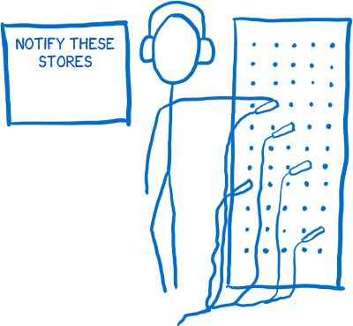
Dispatchers
Dispatchers are the central hubs that manage data flow.
Essentially registry of callbacks into Stores
When Actions passed into the central Dispatcher,
they are redistributed to the Stores.
Dispatchers manage dependencies between Stores.

Slide 22

Stores
Stores contain the application state and logic(sort of like the Model in MVC)
Stores register themselves with the Dispatcher to receive Actions via a callback.
Actions describe state changes in the Store.
Stores broadcast an event saying they have changed so Views can update.

Slide 23

Views
Views are the components
Components are composable and are typically nested in a tree hierarchy.
A special “App View” behaves like a controller-view and provides glue code to propagate states down the chain.
Events cause Views to request the State from a Store

Slide 24
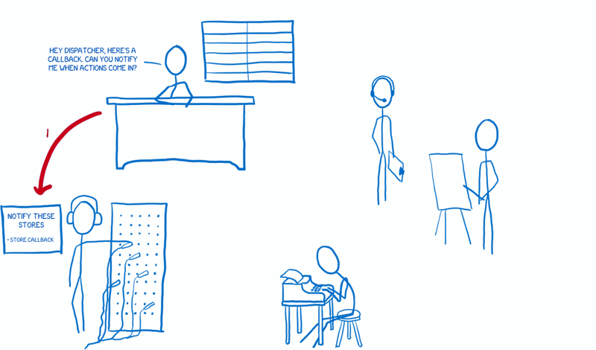
How it works?
‹#›

Slide 25
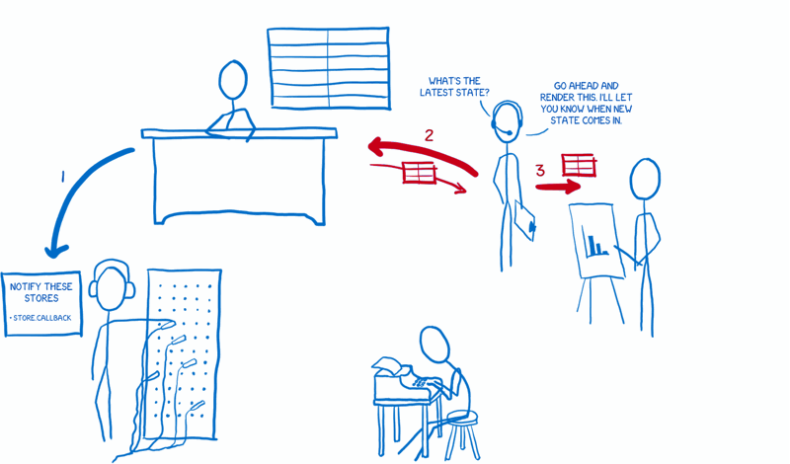
How it works?
‹#›

Slide 26
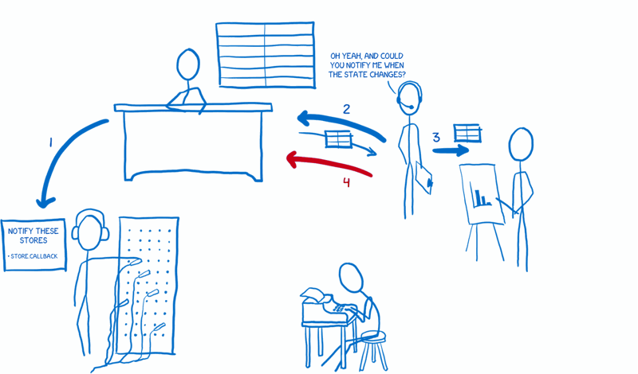
How it works?
‹#›

Slide 27
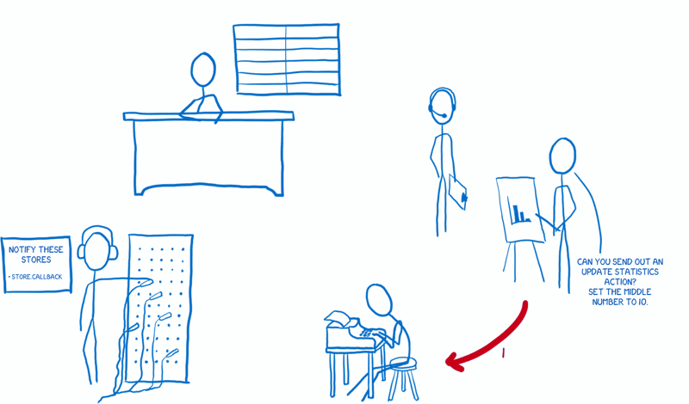
How it works?
‹#›

Slide 28
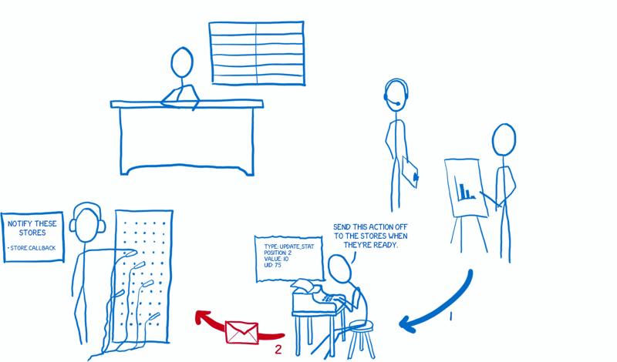
How it works?
‹#›

Slide 29
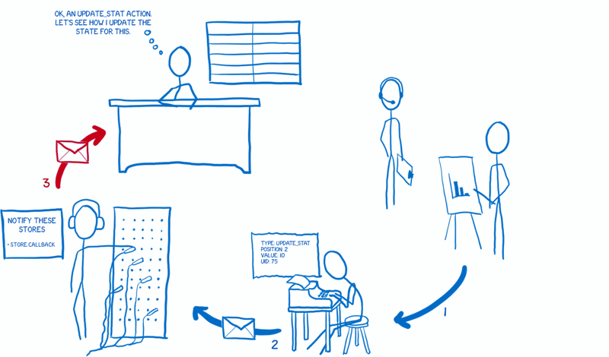
How it works?
‹#›

Slide 30
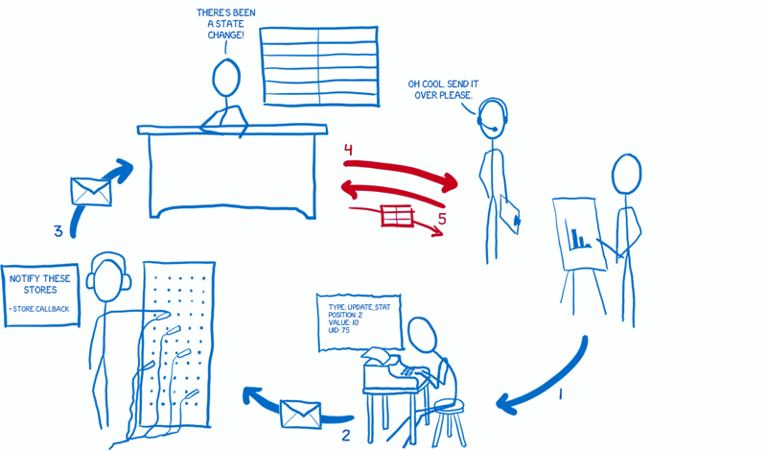
How it works?
‹#›

Slide 31
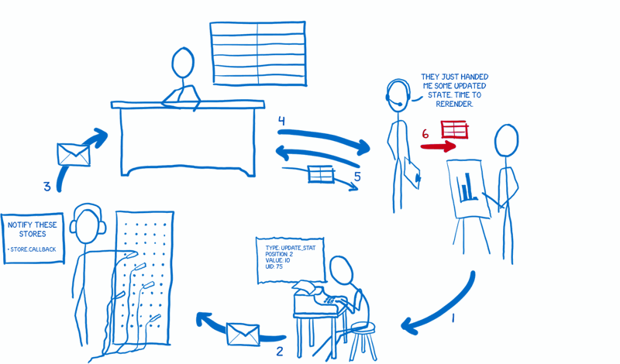
How it works?
‹#›

Slide 32
Flux Implementations
Several different implementations of Flux:
Flux by Facebook
Redux by Dan Abramov
Alt by Josh Perez
Reflux by Mikael Brassman
Fluxxor by Michelle Tilley
‹#›

Slide 33
Redux
Redux evolves the ideas of Flux, but avoids its complexity.
The Principles of Redux
The whole state of your app is stored in an object tree inside a single store.
The only way to change the state tree is to emit an action, an object describing what happened.
To specify how the state tree is transformed by actions, you write pure reducers.
‹#›

Slide 34
Store API
dispatch(action) – dispatches an action. This is the only way to trigger a state change
subscribe(listener) – adds a change listener. It will be called any time an action is dispatched, and some part of the state tree may potentially have changed
getState() – returns the current state tree of your application
replaceReducer(nextReducer) – replaces the reducer currently used by the store
‹#›

Slide 35
Redux flow
‹#›

Slide 36
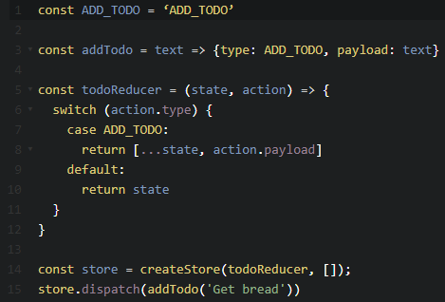
Redux
‹#›

Slide 37
Thank you!
‹#›

